Slide 1

Active Contour External Force Using Vector Field Convolution for Image Segmentation
By Bing Li and Scott T. Acton
Oral presentation
Paumier Nicolas & This Alexandre
Introduction to medical imaging

Slide 2
Active contours : Goal

Slide 3
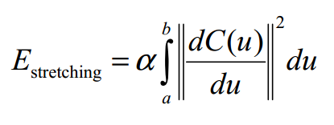
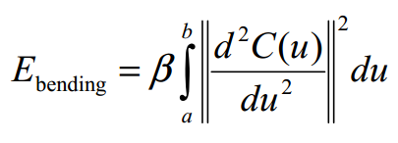
Active contours – Energy minimisation Internal energy

Slide 4
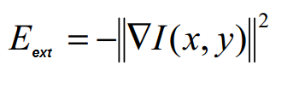
Active contours – Energy minimisation External energy

Slide 5
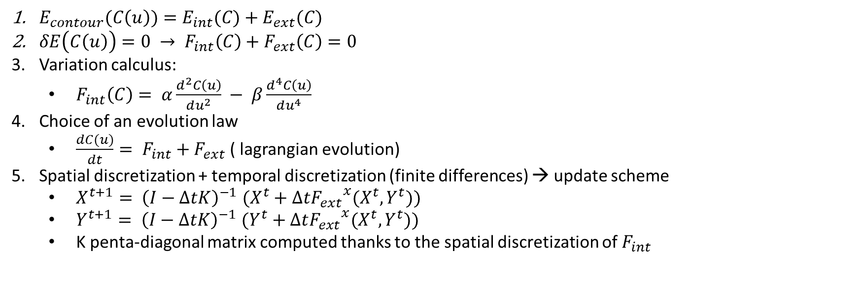
Active contours : Update scheme
$E_{contour}(C\left(u\right))=E_{int}(C)+E_{ext}(C)$
$δE\left(C\left(u\right)\right)=0 → F_{int}\left(C\right)+F_{ext}\left(C\right)=0$
Variation calculus:
$F_{int}\left(C\right)= α\frac{d^{2}C\left(u\right)}{du^{2}} − β\frac{d^{4}C\left(u\right)}{du^{4}}$
Choice of an evolution law
$\frac{dC(u)}{dt}= F_{int}+F_{ext}$ ( lagrangian evolution)
Spatial discretization + temporal discretization (finite differences) → update scheme
$X^{t+1}{= \left(I−ΔtK\right)}^{−1}(X^{t}+Δt{F_{ext}}^{x}(X^{t},Y^{t}))$
$Y^{t+1}{= \left(I−ΔtK\right)}^{−1}(Y^{t}+Δt{F_{ext}}^{x}(X^{t},Y^{t}))$
K penta-diagonal matrix computed thanks to the spatial discretization of $F_{int}$

Slide 6
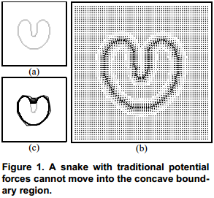
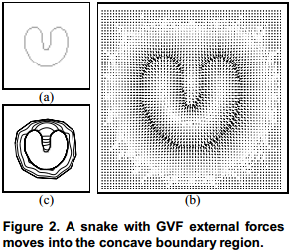
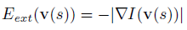
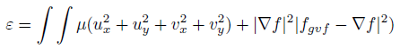
External force using Gradient Vector Flow
Traditional external energy : difficulty with concavities
New potential field
minimizing :
Drawbacks
High computational cost
Sensibility to noise and parameters
Unclear relation between capture range and parameters
Credit Xu & Prince

Slide 7
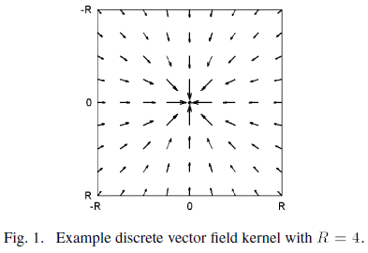
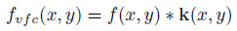
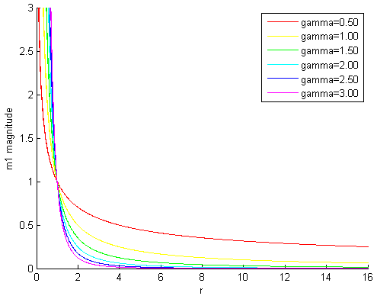
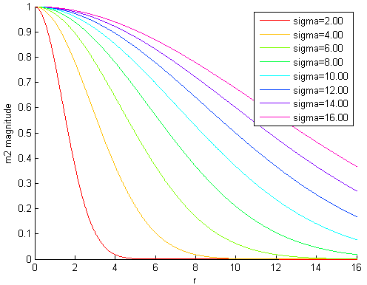
External Force using Vector Field Convolution
GVF :
VFC :
with
Advantages
Speed up computation
Controllability
Generality
Local calculation

Slide 8
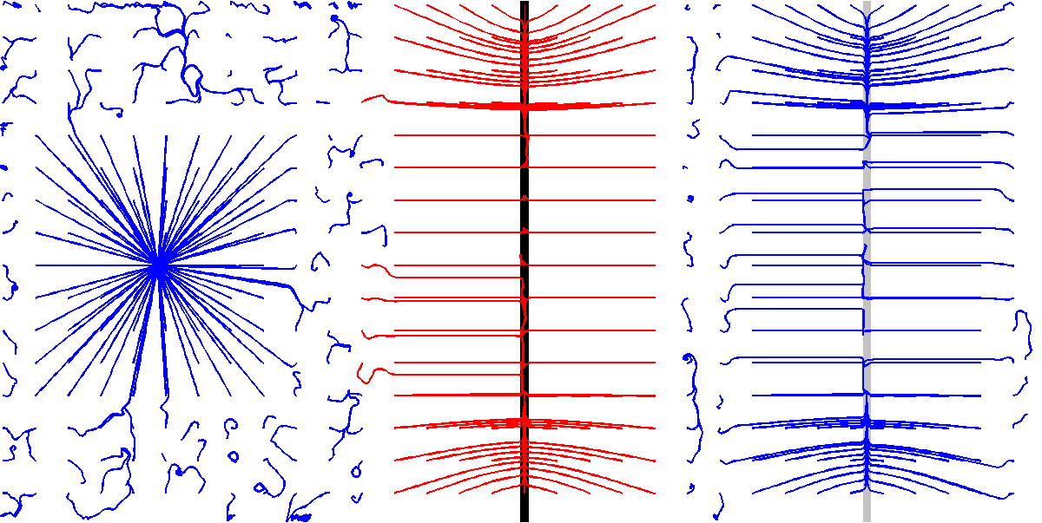
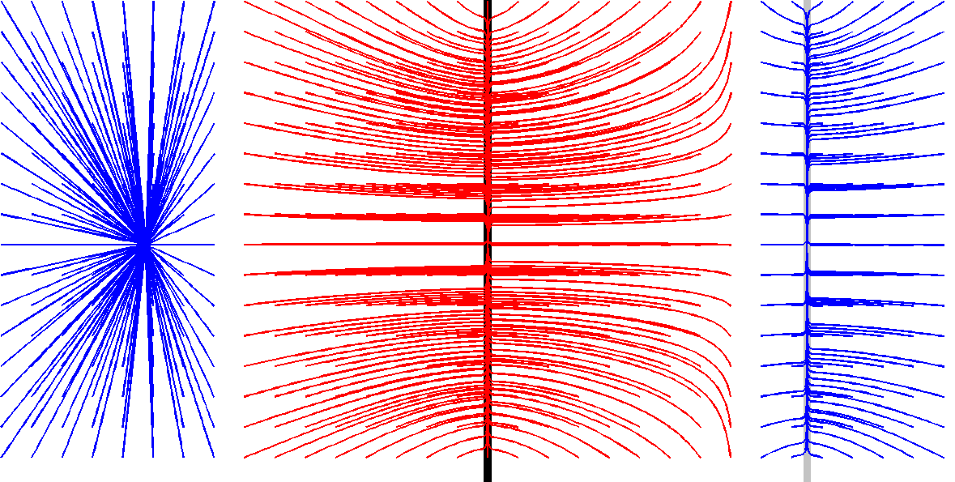
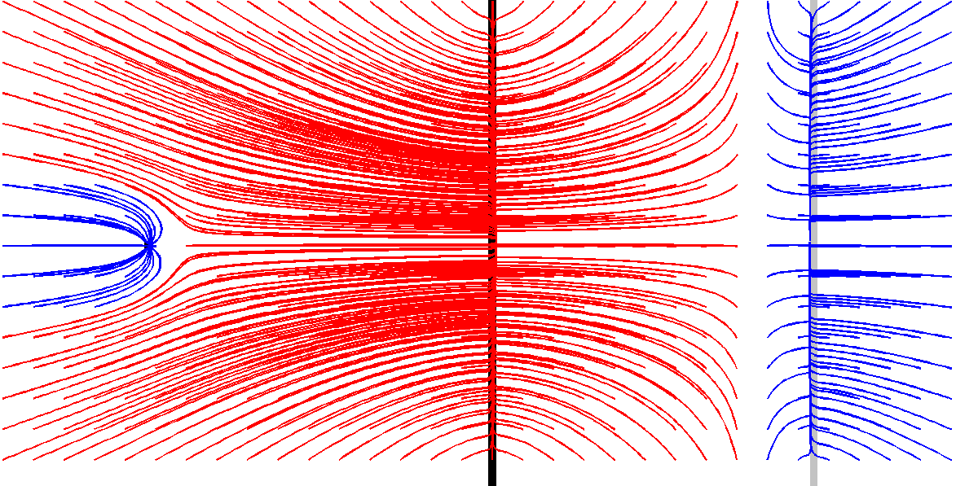
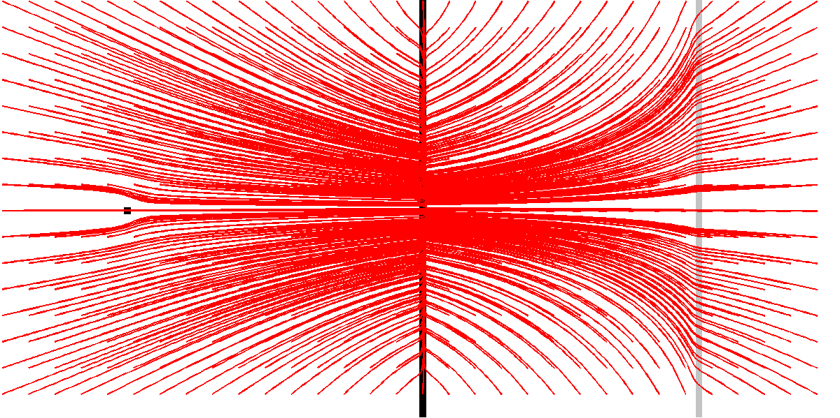
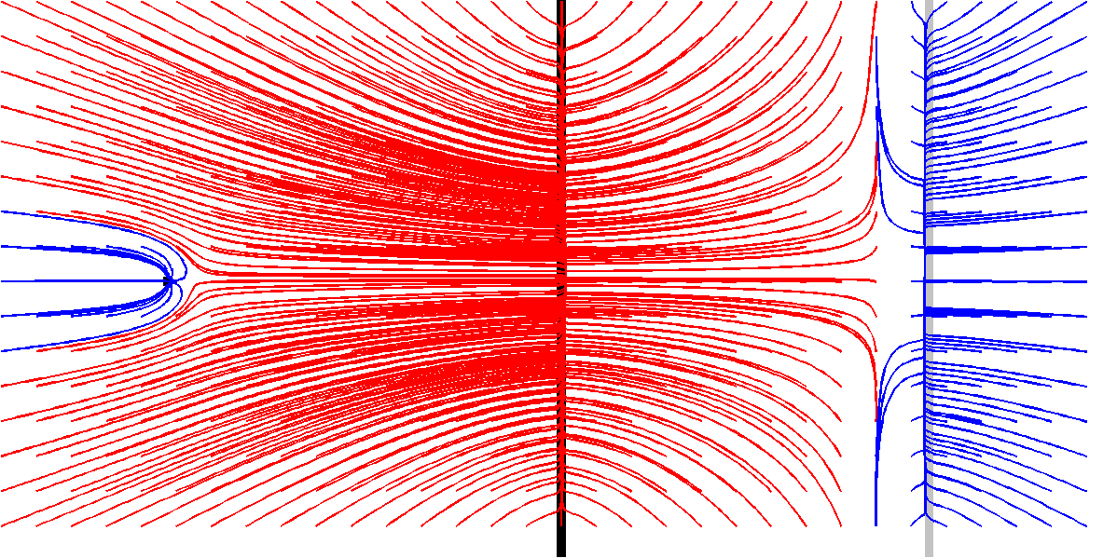
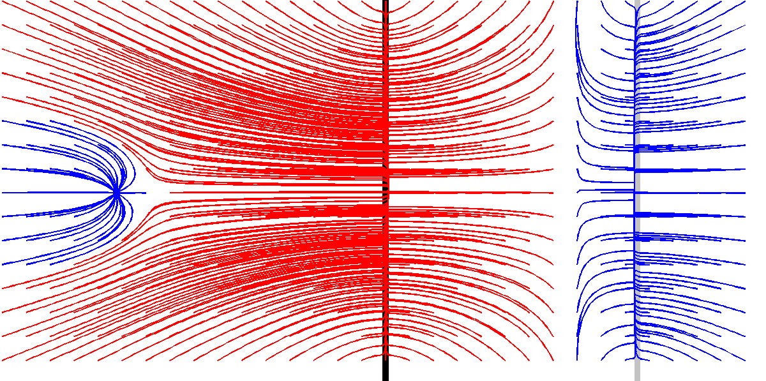
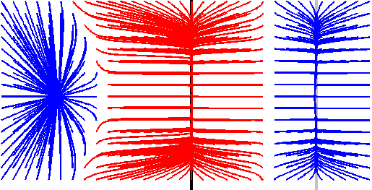
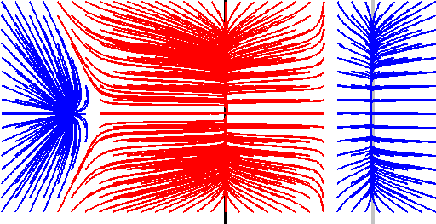
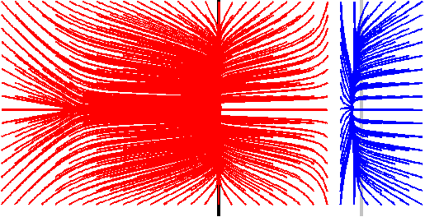
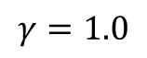
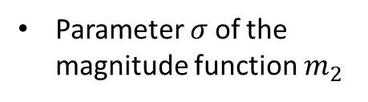
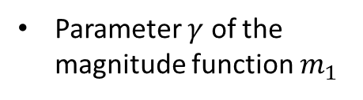
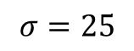
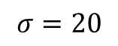
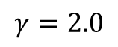
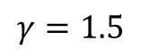
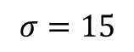
VFC Parameters
Size R of the convolution kernel
R = 16
R = 32
R = 64
Parameter $γ$ of the magnitude function $m_{1}$
$$γ=1.0$$
$$γ=1.5$$
$$γ=2.0$$
Parameter $σ$of the magnitude function $m_{2}$
$$σ=15$$
$$σ=20$$
$$σ=25$$

Slide 9
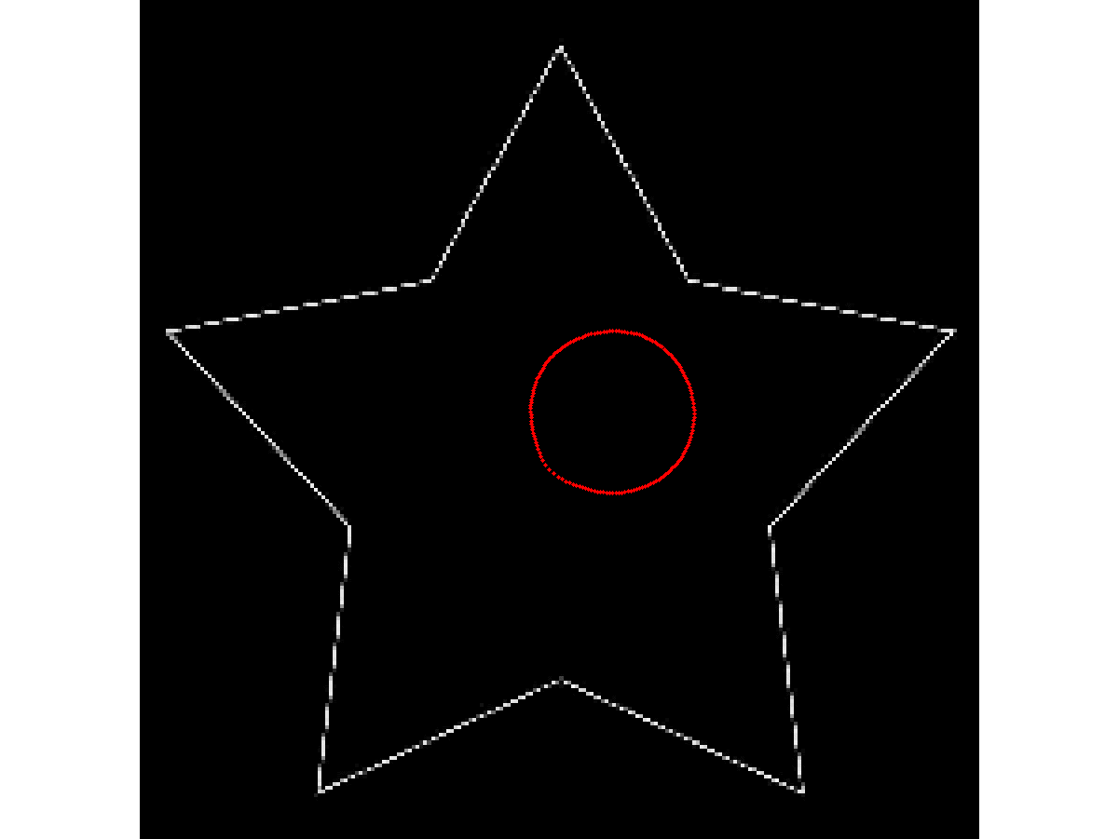
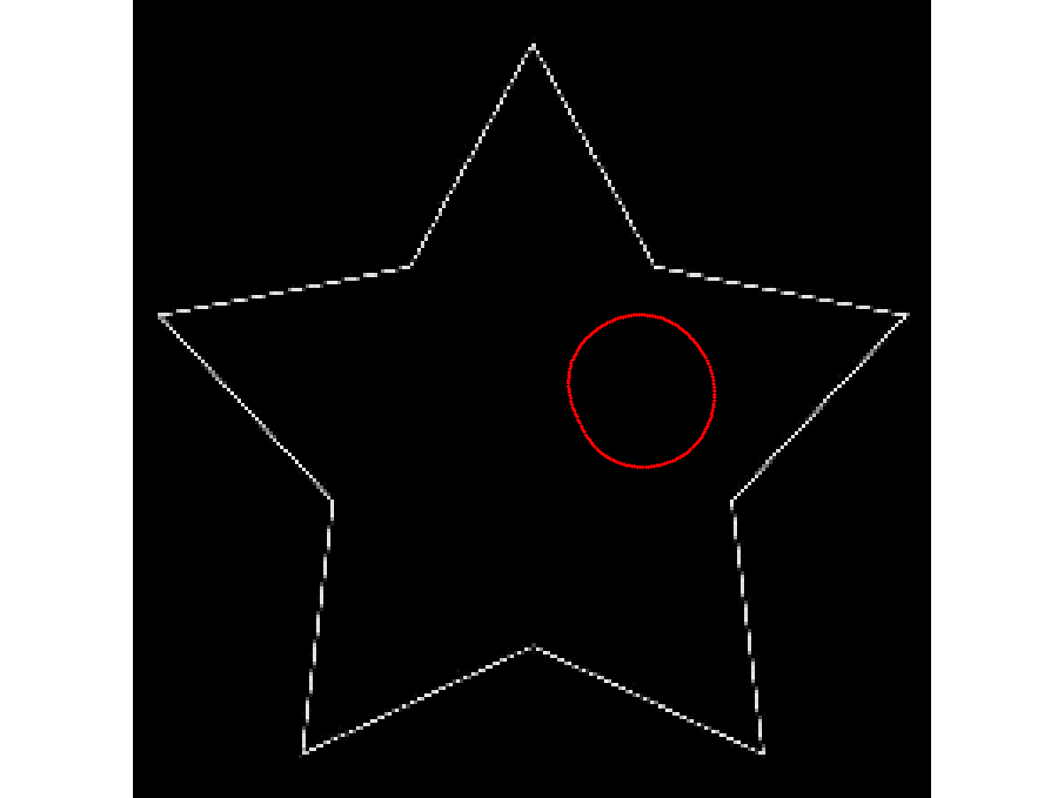
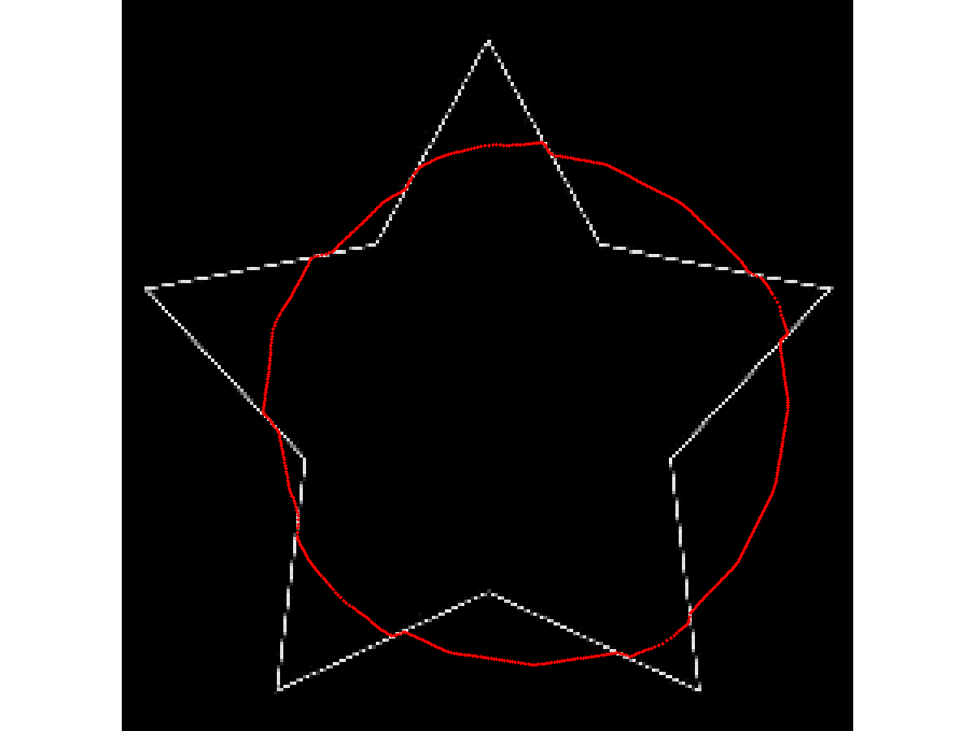
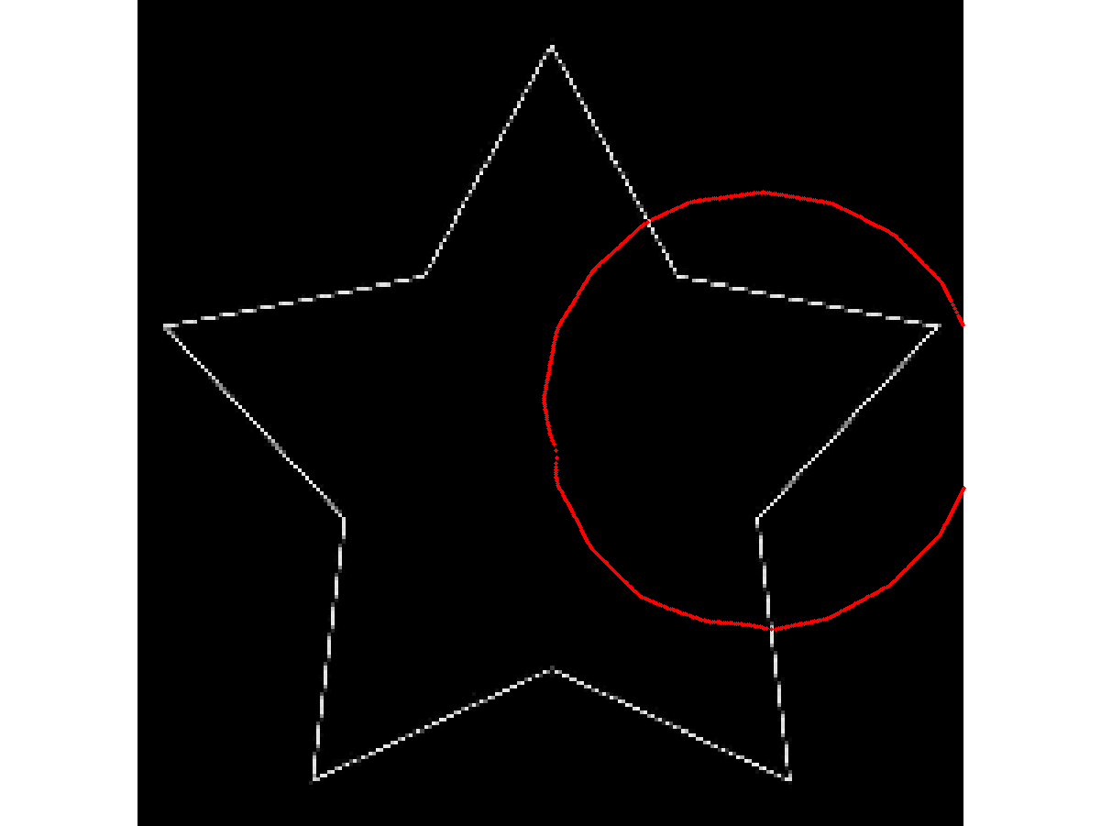
Robustness to contour initialisation

Slide 10
Convergence concavités - Alex

Slide 11
Bruit - Alex

Slide 12
Conclusion - Alex

Slide 13
Ouverture - Alex

